Slide 1
INF10025
Data Management and Analytics
Week 03 – Part 1
Queries with Parameters

Slide 2
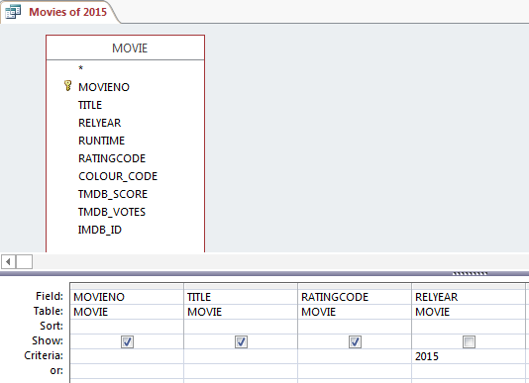
Queries with Parameters
This example creates a query which retrieves all movies with the release year 2015

Slide 3

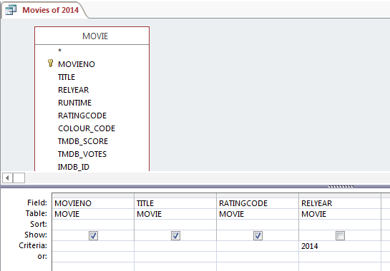
Queries with Parameters
We could create a similar query for movies of 2014.
Eventually you create a number of very similar queries that simply have a different criteria value.
A long list of queries leads to clutter and confusion.

Slide 4
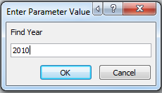
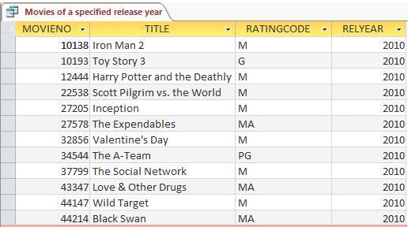
Queries with Parameters
An alternative, is to create a Query Parameter
A parameter is a temporary storage location that is given a name
E.g. Find Year
Then in the criteria for year add this:
= [Find Year]
When you run the query, Access will ask you a question
Finally the correct records are retrieved

Slide 5
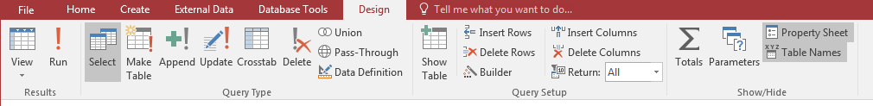
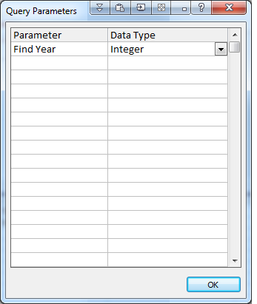
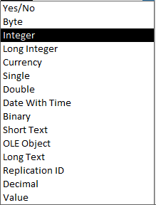
Queries with Parameters
Click on the Parameters icon in the
You create a Parameter Name.
The name may contain spaces.
You specify a data type for the parameter
Generally you would use:
ShortText
Date
Integer – whole number no decimal
Decimal – a number with decimal places

Slide 6
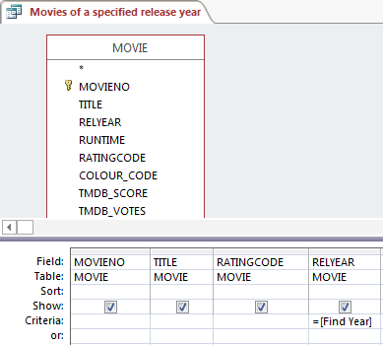
Queries with Parameters
Add the parameter name to the Criteria for the RelYear field and run the query.

Slide 7
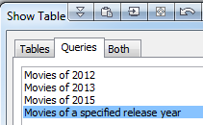
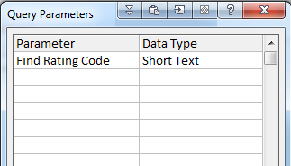
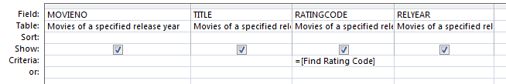
Queries with Parameters
You can combine two queries with parameters
This new query uses Movies of a Specified Rating and Year as its source
It uses a new Parameter named Find Rating Code

Slide 8
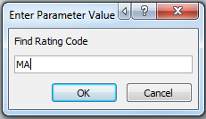
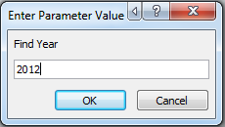
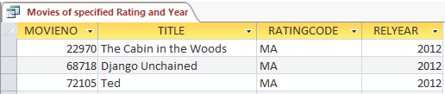
Queries with Parameters
When the query is executed, both parameters are deployed to retrieve the required records

Slide 9
Copying tables
We are about to make a copy of a table.
This is something that you generally want to avoid. Why ?
Imagine a Student table. It stores your id, name, address, phone number…
Now if you make a copy of the table, two tables store your id, name, address, phone…
If you make a change to your phone no, which table should get updated?
Can you guarantee that both tables are updated? No.
Is it possible for the data is two tables to get 'out of synch'? Yes.
Storing the same data in two tables causes Redundant Data.
Data redundancy can lead to:
* multiple versions of the truth
loss of data integrity
However we sometimes want to play or test some Data and we can Simply make a Copy of Table and paste it in Access. Then use this Copied Table to play with the Data

Slide 10
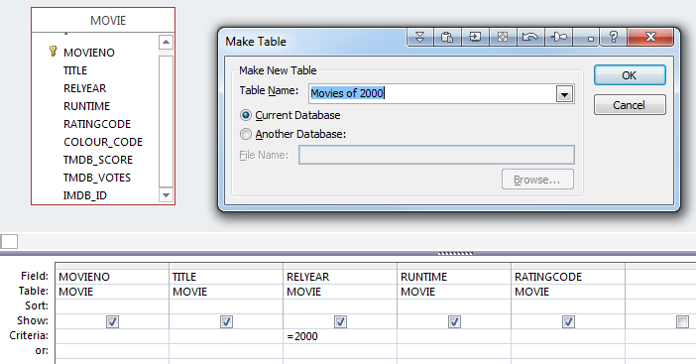
Make Table and Append
Suppose you want to make a copy of the movies of the year 2000 and store them in a separate table.
You can copy rows from the movie table
to a new table named Movies of 2012
You can use the Make Table
icon. When executed via the run icon
a new table is created.
Warning: This causes
Redundant Data!
Useful if you want a new
table for testing purposes
or similar.

Slide 11
Append Query
This option is similar to the Make Table option.
Instead of making a new table, records selected by this query are appended to an existing table.
You have to ensure that the fields on the original table
match the fields that you select in the Append Query.
The Make Table and Append queries should be use sparingly (if at all).
Again, best used for testing purposes only.

